Slide 1

INSTITUTE UIE
DEPARTMENT ACADEMIC UNIT-1
Bachelor of Engineering (Computer Science & Engineering)
Subject Name Semi Conductor Physics
Subject Code 23SPH-143
Prepared By
Ms. Neetu
Lecture-3.1.2
Types of RE energy Sources.
DISCOVER . LEARN . EMPOWER

Slide 2
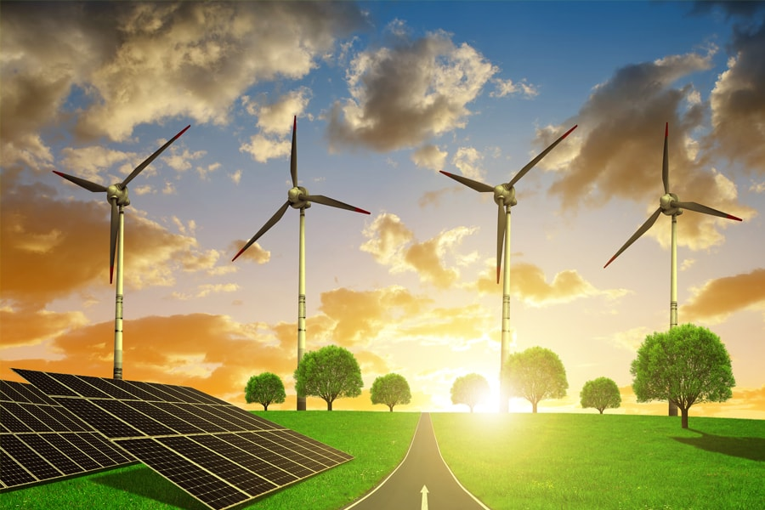
Lecture Objectives
S. No. | Objectives
1 | To make student aware about the types of Renewable energy Sources (RE sources)
2 | To make student aware about limitations of RE sources
3 | To provide knowledge about types of RE sources
4 | To make familiar with types of RE sources.
5 | To give brief knowledge about their limitations.
https://www.cmu.edu/energy/news-multimedia/2018/17-year-leader.html/

Slide 3
Course Objectives
S. No. | Objectives
1 | To understand the basic materials and properties of semiconductors
2 | Understand the basic of semiconductor and components like diode, transistor, FET, MOSFET and Energy Sources.
3 | To give knowledge about semiconductor physics and discus working and applications of basic devices, including p-n junctions, BJTs and FETs.
https://www.cmu.edu/energy/news-multimedia/2018/17-year-leader.html/

Slide 4
Course Outcomes
CO1 | To apply the knowledge of basic semiconductor material physics and understand fabrication processes. | CO1
CO2 | To understand the characteristics of different electronic devices such as diodes, transistors. | CO2
CO3 | To derive the relationships between the parameters in diode, FET, configurations of Transistor and MOSFETs. | CO3
CO4 | To describe the working and design considerations for the various photonic devices like photo detectors, solar-cells and LEDs. | CO4
CO5 | To provide problem solving experience and learning of concepts through it in semiconductor physics. | CO5
CO1 | To apply the knowledge of basic semiconductor material physics and understand fabrication processes. | CO1
https://www.cmu.edu/energy/news-multimedia/2018/17-year-leader.html/

Slide 5
TYPES OF RE SOURCES
RE sources: Renewable energy sources
energy produced from sources that do not deplete or can be replenished
comes from natural processes
cheap
minimal impact to the environment

Slide 6
TYPES OF RE SOURCES
Solar energy
Wind energy
Hydro energy
Tidal energy
Geothermal energy
Biomass energy
Hydrogen

Slide 7
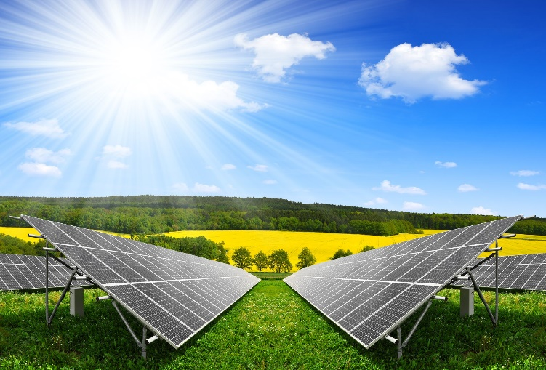
TYPES OF RE SOURCES
Solar Energy
energy captured from sun in the form of sunlight
form of light and heat
Solar cells convert sunlight into electricity
solar energy technologies include photovoltaic cells and panels, concentrated solar energy, and solar architecture.
use in homes, businesses, schools, and hospitals
https://okcredit.in/blog/why-you-should-switch-to-solar-energy-in-india/

Slide 8
TYPES OF RE SOURCES
Wind Energy
clean, free, and readily available
A form of solar energy : uneven heating and cooling of the atmosphere cause winds
Wind turbines convert wind into electricity
Wind blows, the turbine's blades spin clockwise, capturing energy
Gearbox sends that wind energy to the generator, converting it to electricity
windmills used to pump water on farms

Slide 9
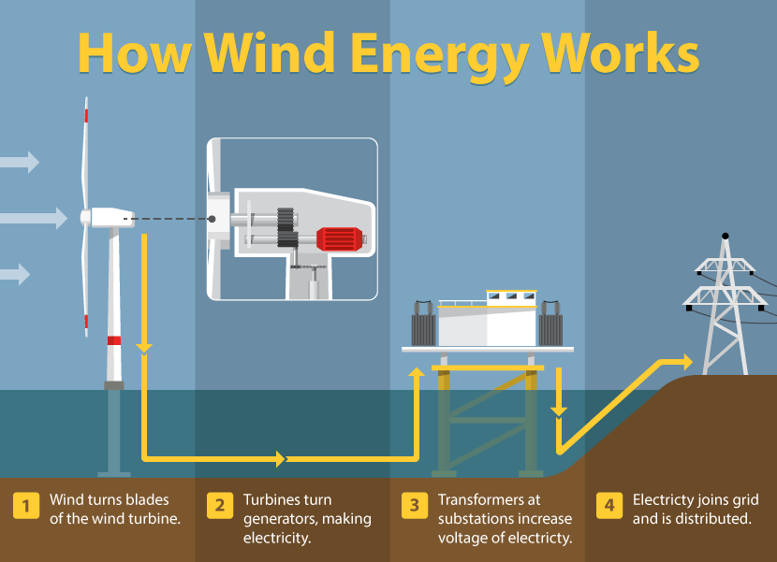
TYPES OF RE SOURCES
https://www.fix.com/blog/understanding-renewable-energy/

Slide 10
TYPES OF RE SOURCES
Hydro Energy
Hydroelectric energy or Hydro energy
Uses the power of moving water to generate electricity
Dams are constructed to store water in a reservoir which, when released, flows through turbines to produce electricity
China - largest producer of hydroelectricity
Around the world producers - The United States, Brazil, Canada, India, and Russia
Renewable electricity generated on Earth from hydropower – 71%

Slide 11
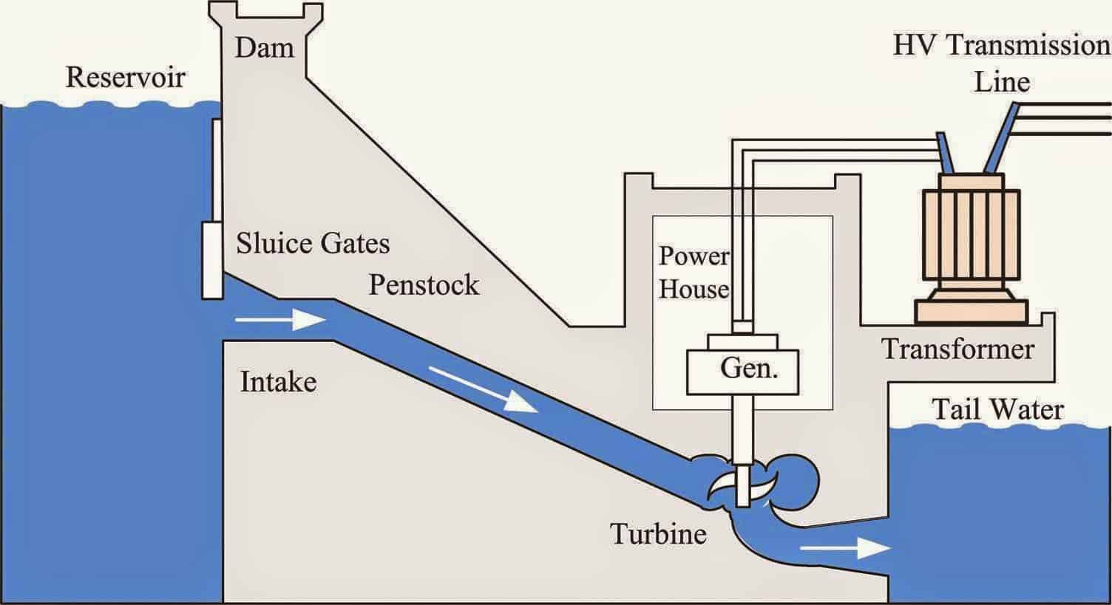
TYPES OF RE SOURCES
Hydro Power Generation
https://renewablepedia.com/information-about-hydropower/

Slide 12
TYPES OF RE SOURCES
4. Tidal Energy
Two types of energy produced from ocean: thermal energy and tidal energy
Tidal energy: mechanical energy from the motion of tides and waves
Still in its infancy stage
few commercial-sized tidal power plants operating
The first was located in La Rance, France
largest - Sihwa Lake Tidal Power Station in South Korea
future looks promising as 70% of the surface of our planet covered by ocean

Slide 13
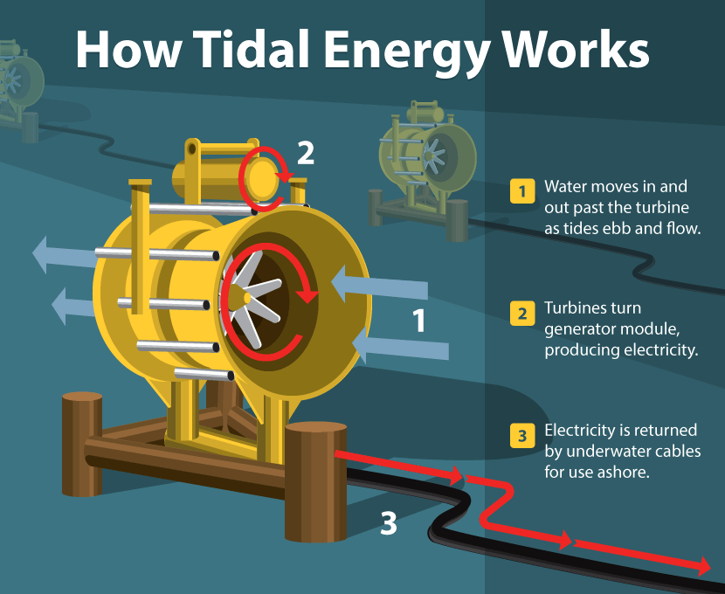
TYPES OF RE SOURCES
https://www.fix.com/blog/understanding-renewable-energy/

Slide 14
TYPES OF RE SOURCES
5. Geothermal energy
Derived from the heat of the earth
Heat from the Earth’s core is constantly radiating outward and warming rocks, water, gas, and other geological material
Hot water can be released through geysers, hot springs, steam vents, underwater hydrothermal vents, and mud pots
Heat can be captured and used directly for heat, or their steam can be used to generate electricity
Geothermal power plants harness these heat sources to generate electricity
used to heat structures such as buildings, parking lots, and sidewalks

Slide 15
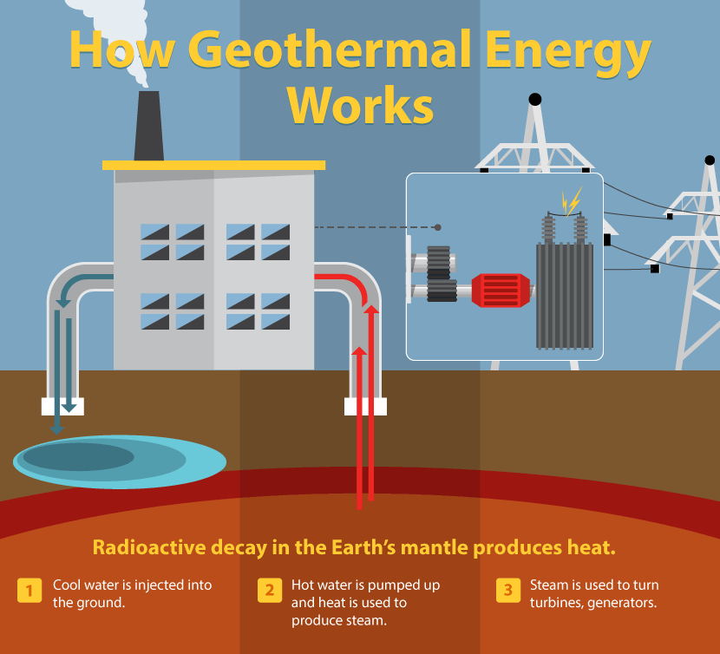
TYPES OF RE SOURCES
https://www.fix.com/blog/understanding-renewable-energy/

Slide 16
TYPES OF RE SOURCES
6. Biomass Energy
Derived from biomass to create heat and electricity or to produce liquid fuels such as ethanol and biodiesel used for transportation
Biomass - any organic matter coming from recently living plants or animals
Most common biomass materials used for energy - plants, wood, and waste
Environmental impact relatively neutral - the same amount of carbon dioxide as fossil fuels, the replacement plants are grown as biomass to remove an equal amount of CO2 from the atmosphere
Biomass can be burned to create heat (direct), converted into electricity (direct), or processed into biofuel (indirect)

Slide 17
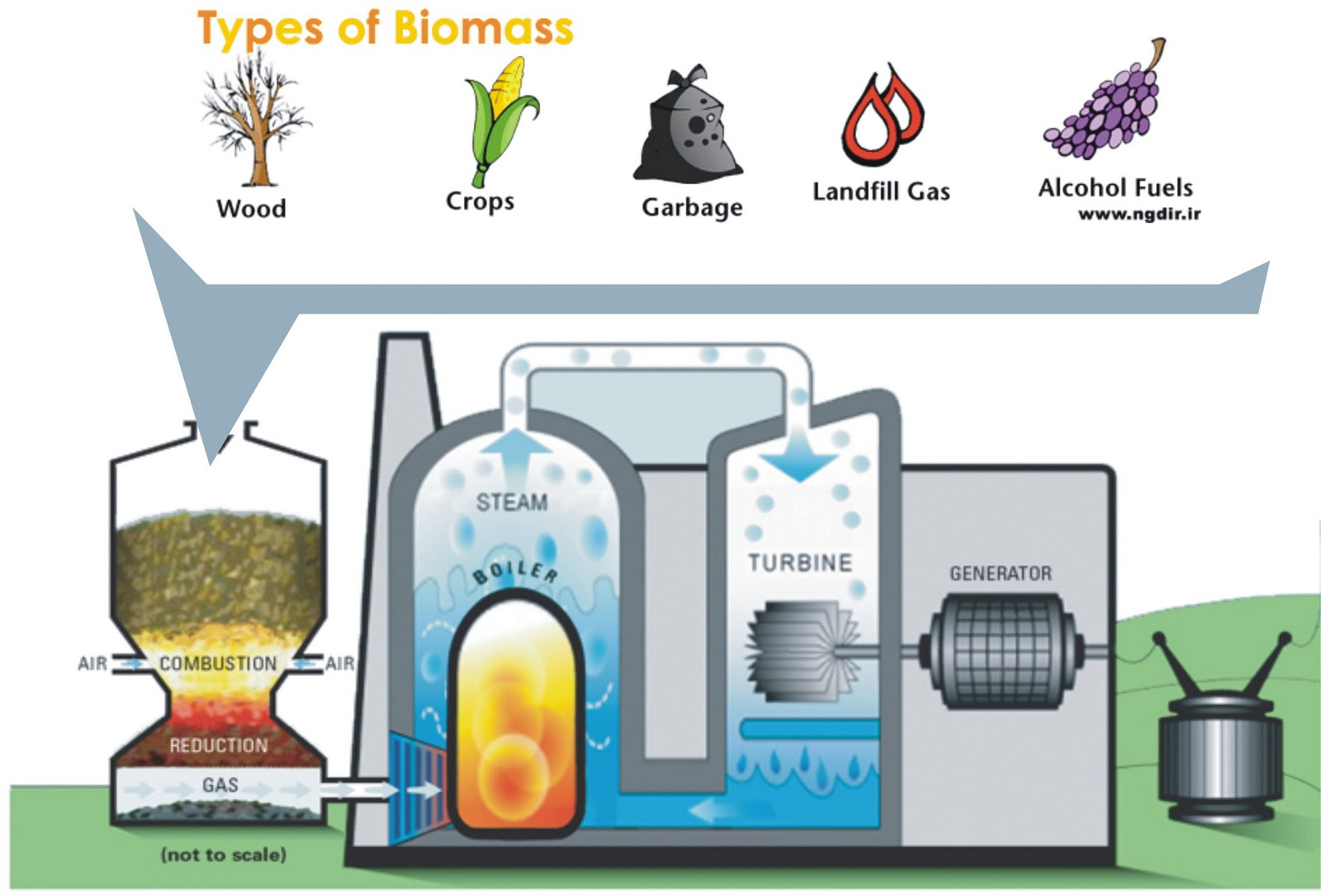
TYPES OF RE SOURCES
https://www.energycompanynumbers.co.uk/renewable-energy-explained/

Slide 18
TYPES OF RE SOURCES
Hydrogen
Clean energy
Hydrogen is the simplest (comprised of one proton and one electron) and the most abundant element in the universe, yet it does not occur naturally as a gas on earth
Instead, it is found in organic compounds (hydrocarbons such as gasoline, natural gas, methanol, and propane) and water (H2O)
Consumed in a fuel cell, produces only water, electricity, and heat
Hydrogen and fuel cells can play an important role in our national energy strategy

Slide 19
Limitations of RE Sources
High-Cost Installation - it has a high initial cost
Unreliable Source of Energy Because of Weather Restrictions
Low Energy Output
The Energy Storage Challenge
Production of green energy can also be impacted by geographic considerations -The efficiency of solar panels in Alaska will never match that of solar panels in Colorado or Nevada. On the other hand, Alaska has a far higher concentration of geothermal energy than the east coast does.

Slide 20
Summary
Types of renewable sources
How they are used
Limitations of Renewable sources

Slide 21
Reference links
https://education.nationalgeographic.org/resource/renewable-resources/
https://www.un.org/en/climatechange/what-is-renewable-energy/
https://www.electricrate.com/green-energy/drawbacks-of-alternative-energy/
YouTube link
https://www.youtube.com/watch?v=44Wp3WE1AHs/
https://www.youtube.com/watch?v=TLGyQ5m25dE/

Slide 22
Frequently Asked Questions
What is renewable Energy source?
What are different types of energy sources
How different renewable energy sources are used for power generation?
What are the limitations of different RE Sources

Slide 23
Practice Questions
Q1. Name the types of clean energy sources?
Ans. Wind Energy, Solar Energy, Tidal Energy.
Q2. What is geothermal energy?
Ans. Geothermal energy is derived from the heat of the earth.
Q3. What are the limitations of RE sources?
Ans. High-Cost installation, Unreliable source of energy because of weather restrictions, low energy output ,energy Storage Challenge, production of green energy can also be impacted by geographic considerations

Slide 24

LEARNING OUTCOMES
To make students understand
Concepts of electricity and relate them to practical engineering systems.
Importance of comprehension of electrical systems from electrical safety point of view.
Fundamentals of electric current and its associated quantities.

Slide 25
Course Outcome to Program Outcome Relationship
PO→
Course Outcome | PO1 | PO2 | PO3 | PO4 | PO5 | PO6 | PO7 | PO8 | PO9 | PO10 | PO11 | PO12 | PSO1 | PSO2 | PSO3
CO1 | 3 | 2 | 0 | 0 | 1 | 0 | 0 | 0 | 0 | 0 | 0 | 0 | 2 | 0 | 0
CO2 | 3 | 2 | 0 | 0 | 1 | 0 | 0 | 0 | 0 | 0 | 0 | 0 | 2 | 0 | 0
CO3 | 3 | 2 | 0 | 0 | 1 | 0 | 0 | 0 | 0 | 0 | 0 | 0 | 2 | 0 | 0
CO4 | 3 | 2 | 0 | 0 | 1 | 0 | 0 | 0 | 0 | 0 | 0 | 0 | 2 | 0 | 0
CO5 | 3 | 2 | 0 | 0 | 1 | 0 | 0 | 0 | 0 | 0 | 0 | 0 | 2 | 0 | 0

Slide 26
Assessment Pattern
A Assignment (each assignment) | B Time Bound Surprise Test (each test) | C Quiz (each quiz) | D Mid Semester Test(one per test) | E Homework | F Discussion Forums | G Attendance and engagement Score on BB
10 | 12 | 4 | 20 | NA | NA | 2

Slide 27
References
Textbooks of Basic Electrical & Electronics Engineering:
Websites:

